Slide 1
Capstone Project 2
Heart Stroke Prediction
Presented By: Mrunalini Shende

Slide 2
Table Of Content
Introduction
Problem Statement
Data Dictionary
Implementation
Conclusion

Slide 3
Introduction
The focus of the Heart Stroke Prediction project is to develop a predictive model that estimates the probability of an individual getting a stroke due to various health condition like hypertension, heart disease, bmi, smoking status, etc.

Slide 4
Problem Statement
Develop a machine learning model to predict the likelihood of a patient experiencing a stroke based on various input parameters such as gender, age, presence of diseases, and smoking status. The dataset provides relevant information about each patient, enabling the development of a predictive model.

Slide 5
Data Dictionary
The dataset used in this project contains information necessary to predict the occurrence of a stroke. Each row in the dataset represents a patient, and the dataset includes the following attributes:
id: Unique identifier
gender: "Male", "Female", or "Other"
age: Age of the patient
hypertension: 0 if the patient doesn't have hypertension, 1 if the patient has hypertension
heart_disease: 0 if the patient doesn't have any heart diseases, 1 if the patient has a heart disease
ever_married: "No" or "Yes"
work_type: "Children", "Govt_job", "Never_worked", "Private", or "Self-employed"
Residence_type: "Rural" or "Urban"
avg_glucose_level: Average glucose level in the blood
bmi: Body mass index
smoking_status: "Formerly smoked", "Never smoked", "Smokes", or "Unknown"
stroke: 1 if the patient had a stroke, 0 if not

Slide 6
Implementation
Data Preprocessing:
Checking the shape of data frame
Descriptive statistics
Handing null/missing values
Replacing the missing values with the most frequent value
Replacing the values in columns with numerical values

Slide 7
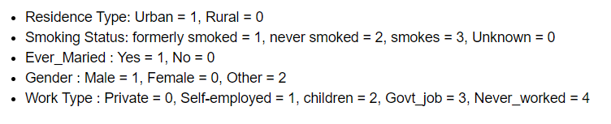
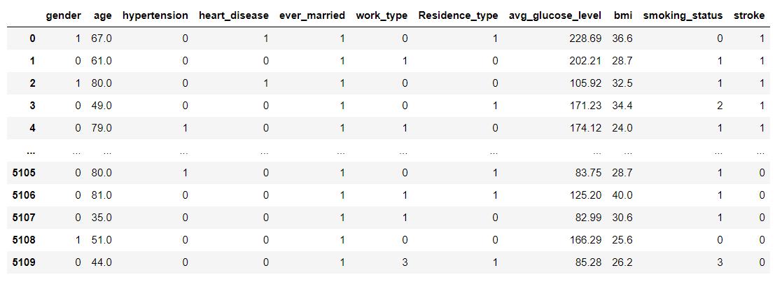
Data Preprocessing for Model Preparation
Replacing the values in columns with numerical values
Categorical values are assigned numerical labels, converting them into a numerical format that algorithms can work with.

Slide 8
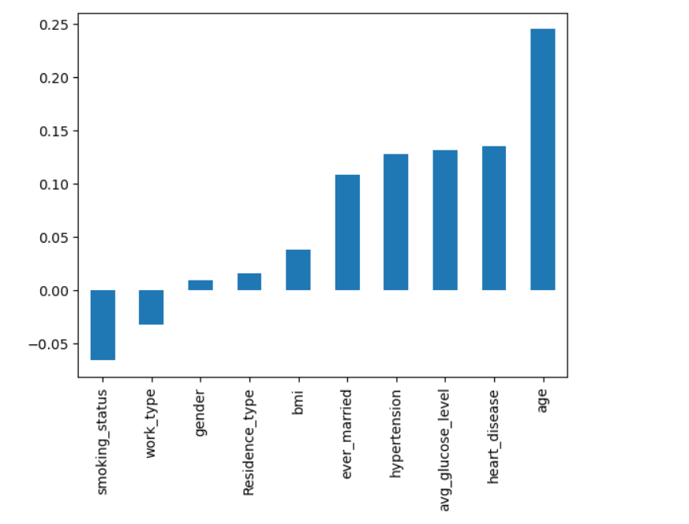
Correlation between the variables

Slide 9
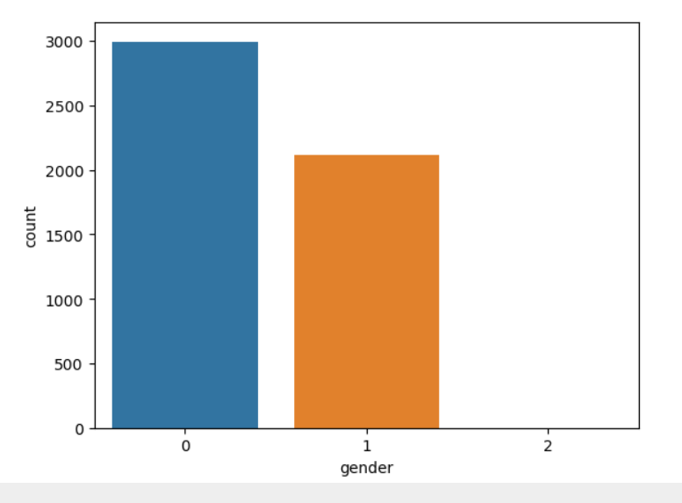
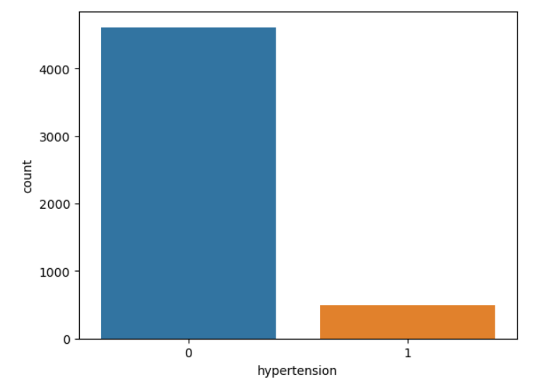
Exploratory Data Analysis(EDA)
In the EDA , I will be looking at the data and try to understand the data. I will begin by looking at the distribution of data across the dataset, followed by visualizing the data to understand the relationship between the features and the target variable.
Distribution of data

Slide 10
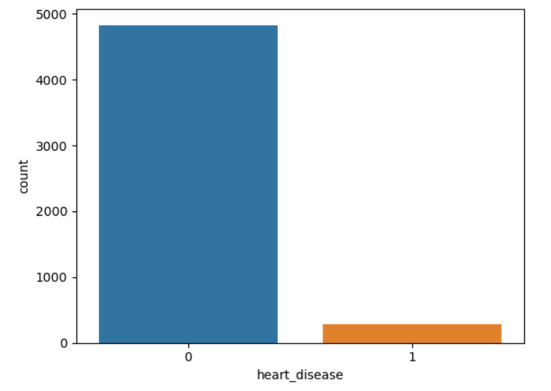
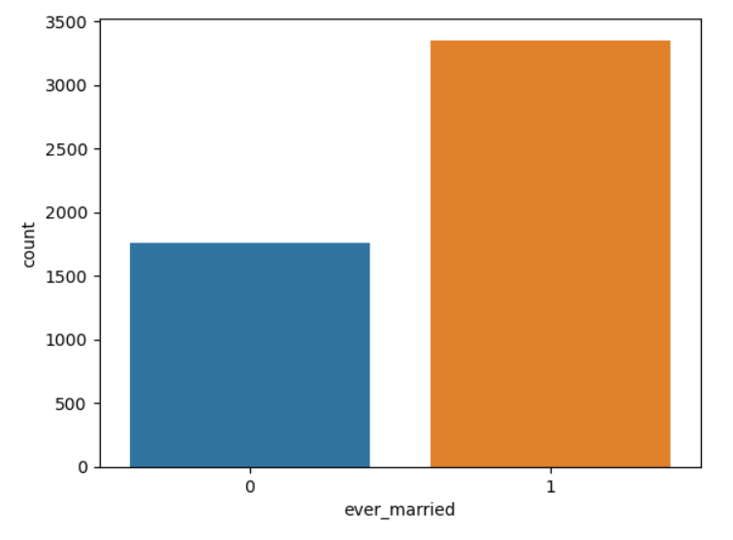
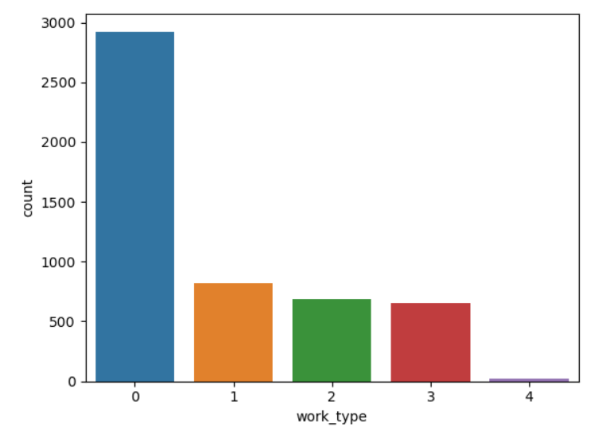
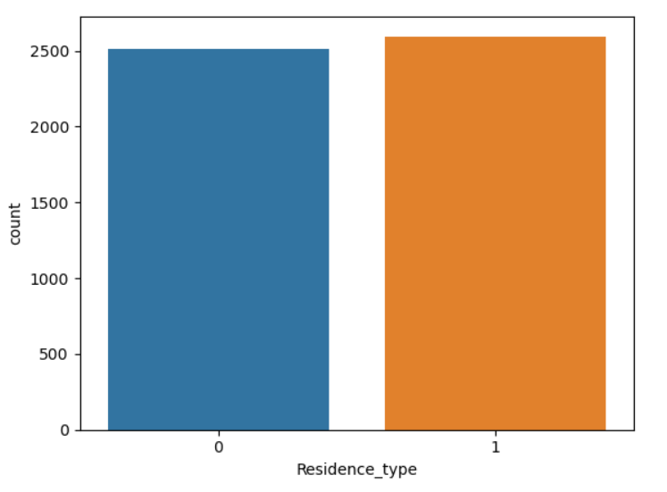
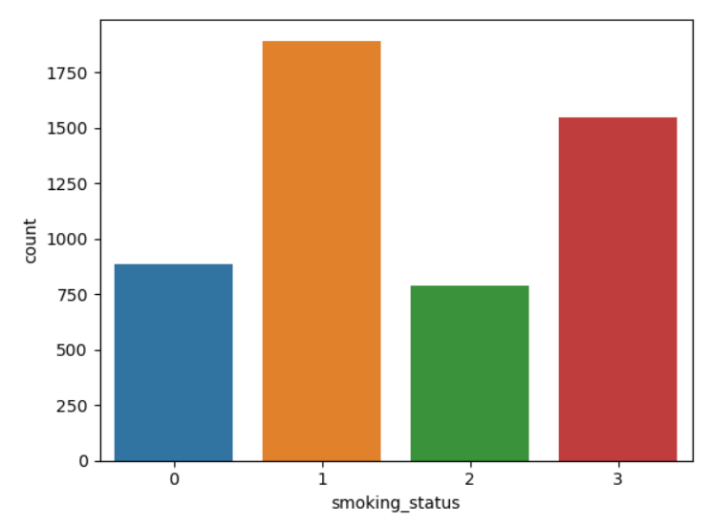
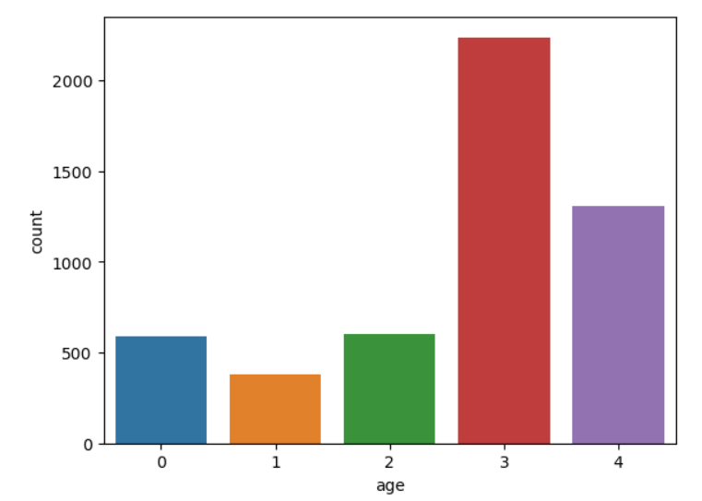

Slide 11
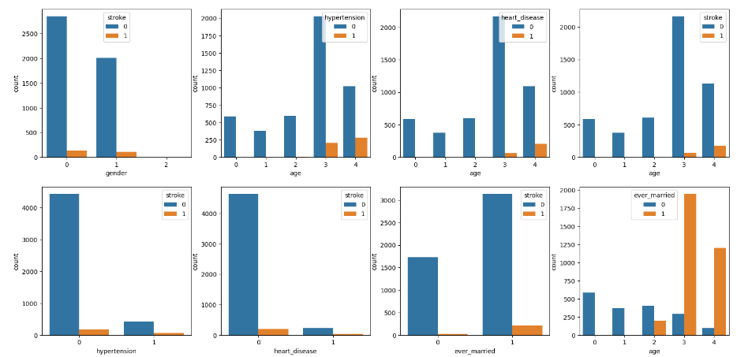
Countplots to represent the occurrence r counts of the observation present in the categorical variable

Slide 12
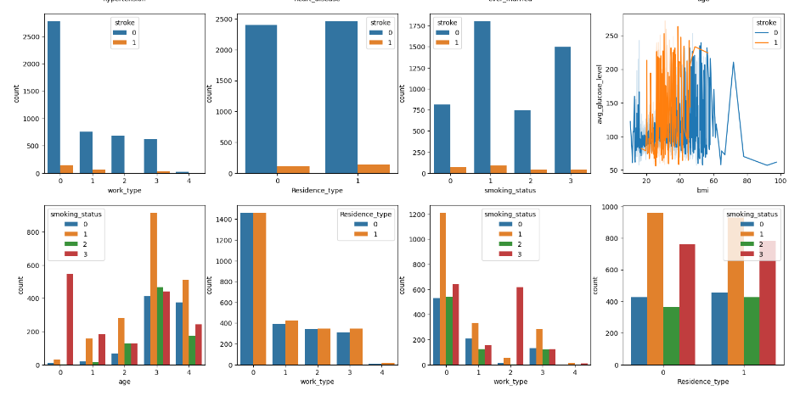

Slide 13
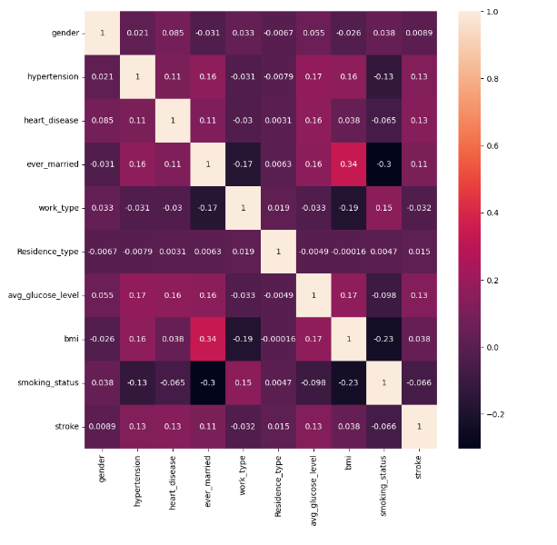
Heatmap for Correlation
There are no major correlations that need attention according to the adjacent heatmap.

Slide 14
Stroke Prediction
The models that were used are:
Logistic Regression
Support Vector Machine(SVM)
Decision Tree Classifier
K-Nearest Neighbors(KNN)

Slide 15
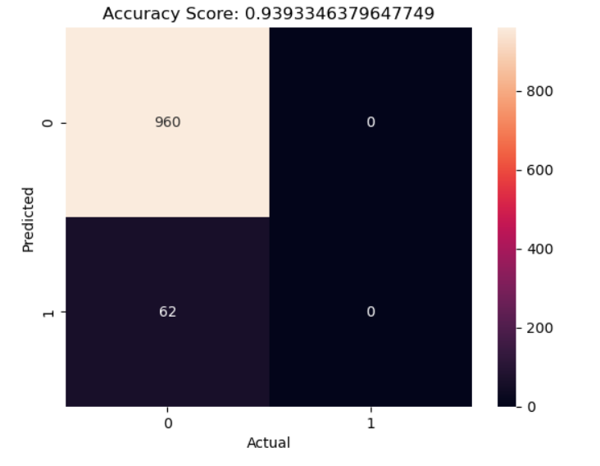
Model Evaluation
A confusion matrix helps us gain insight into how correct our predictions were and how they hold up against the actual values.
Hence for Logistic Regression, the accuracy is as follows:

Slide 16
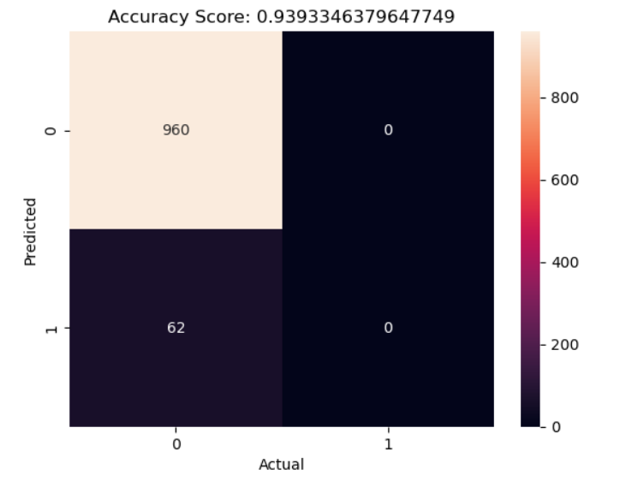
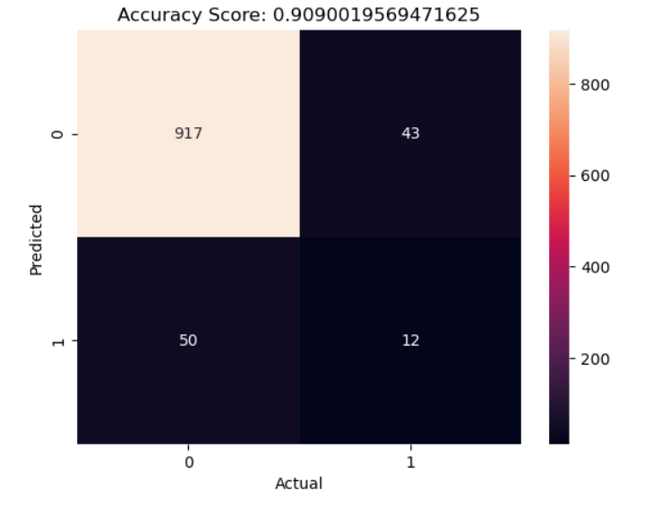
For Support Vector Machine(SVM), the accuracy is as follows:
For Decision Tree Classifier, the accuracy is as follows:

Slide 17
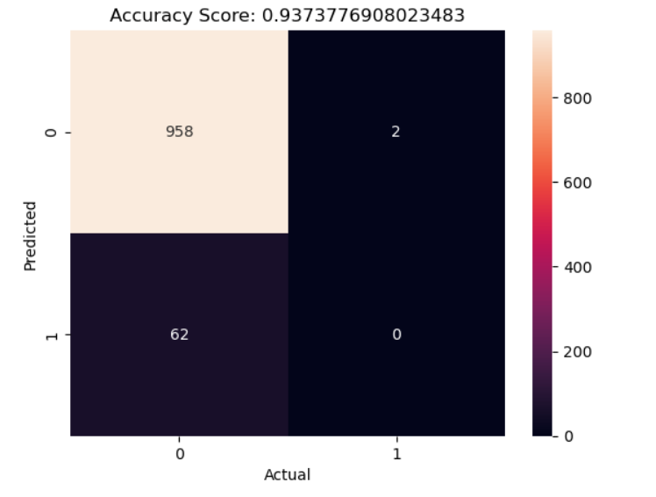
For K-Nearest Neighbors (KNN), the accuracy is as follows:

Slide 18
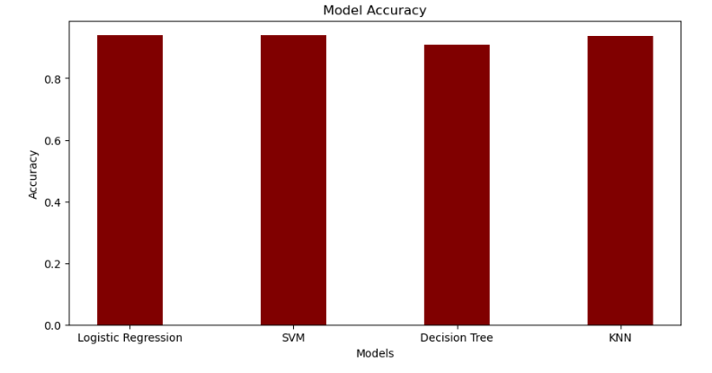
Overall Model Accuracy:

Slide 19
Conclusion
The model accuracies of Logistic Regression, SVM and KNN are quite similar i.e. 93.8 %. The accuracy of Decision Tree Classifier is 91.8 %. So, we can use any of these models to predict the heart stroke.
According to the graphs age v/s hypertension, heart disease showing chances of stroke, the number of person having a stroke shows dependence upon heart disease and hypertension. But when we plot the graph of heart disease and hypertension against the stroke, the persons with lower chances of hypertension and heart disease has increased chances of stroke. This is a peculiar thing and needs to be investigated further. In addition to that non smokers have higher chances of stroke than smokers. This is also a peculiar thing and needs to be investigated further. However person having BMI between 20 to 50 have higher chances of stroke.
Last but not least other features such as martial status, residence type as well as work type are showing effect on the chances of stroke.

Slide 20
Thank You

